Slide 1

Dimension Development
We are a small company based in Madison, WI focusing on affordable housing development for Housing Authorities, municipalities and non-profits
Our Principal Focus: affordable housing development and preservation utilizing HUD, USDA Rural Development and LIHTC funding sources
Our primary roles are as Co Developer, Consultant, or combination for Housing Authorities and Non- Profit Organizations
Founded in 2003, over 1,500 affordable units
developed or preserved

Slide 2
Small (e.g. 1,100 sq. ft.) single family homes
Homes arranged in small “pocket neighborhoods”
A number of these sites would be assembled into a single WHEDA tax credit application
Ideally there would be some ability to offer childcare on some or all of the sites
The homes would be owned by a Limited Liability
Company “LLC”
The LLC would have two members – SWCAP as the Managing Member and an Investor Member (the buyer of the housing tax credits)
The residents of all units would be predominately tax credit eligible, or 100% tax credit eligible?
What is the Driftless Homes
concept

Slide 3
What is a Pocket Neighborhood?
Pocket neighborhoods are clustered groups of neighboring houses or apartments gathered around a shared open space — a garden courtyard, a pedestrian street, a series of joined backyards, or a reclaimed alley — all of which have a clear sense of territory and shared stewardship. They can be in urban, suburban or rural areas.
-Ross Chapin Architects

Slide 4
Are there examples
Typical Pocket Neighborhoods
Oak Grove, Horicon, WI

Slide 5
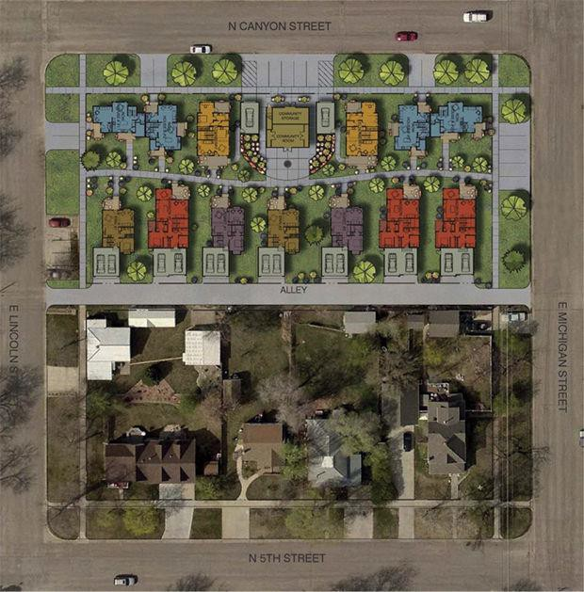

Slide 6
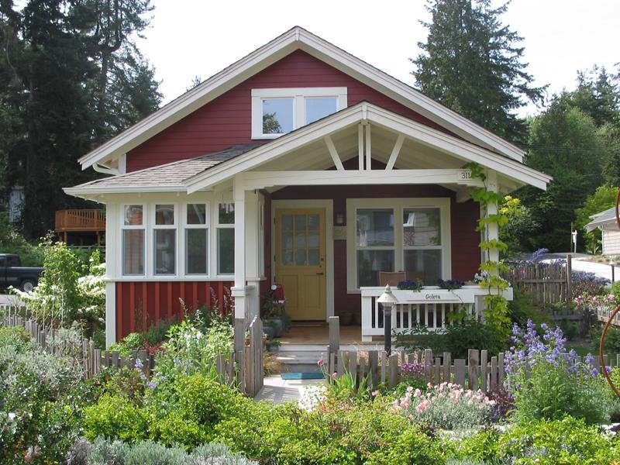

Slide 7
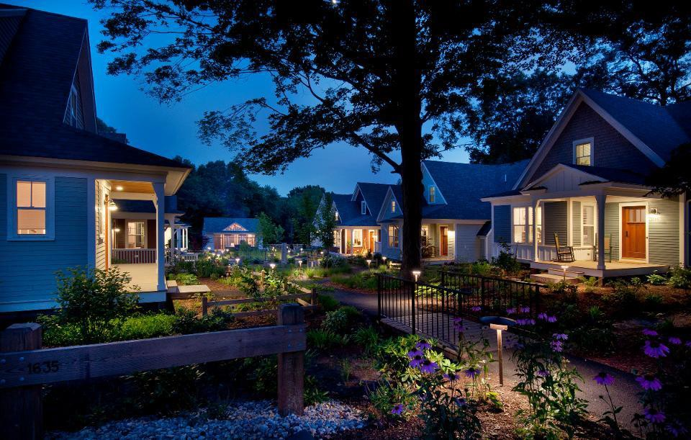

Slide 8
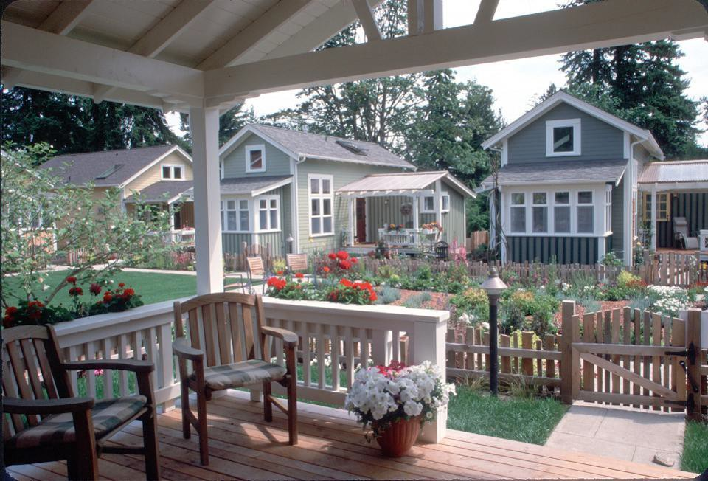

Slide 9
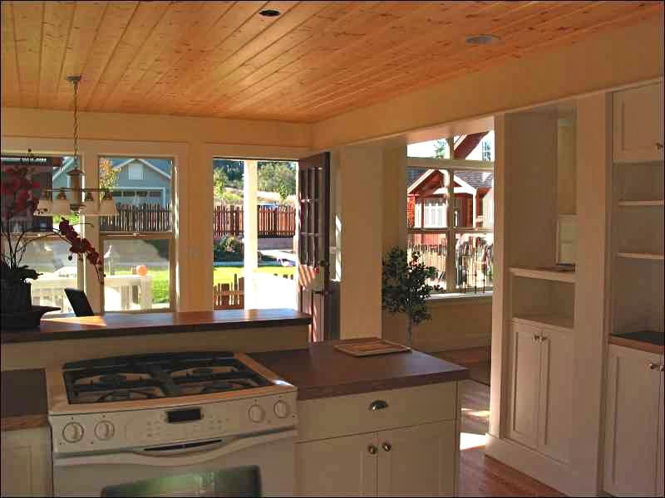

Slide 10
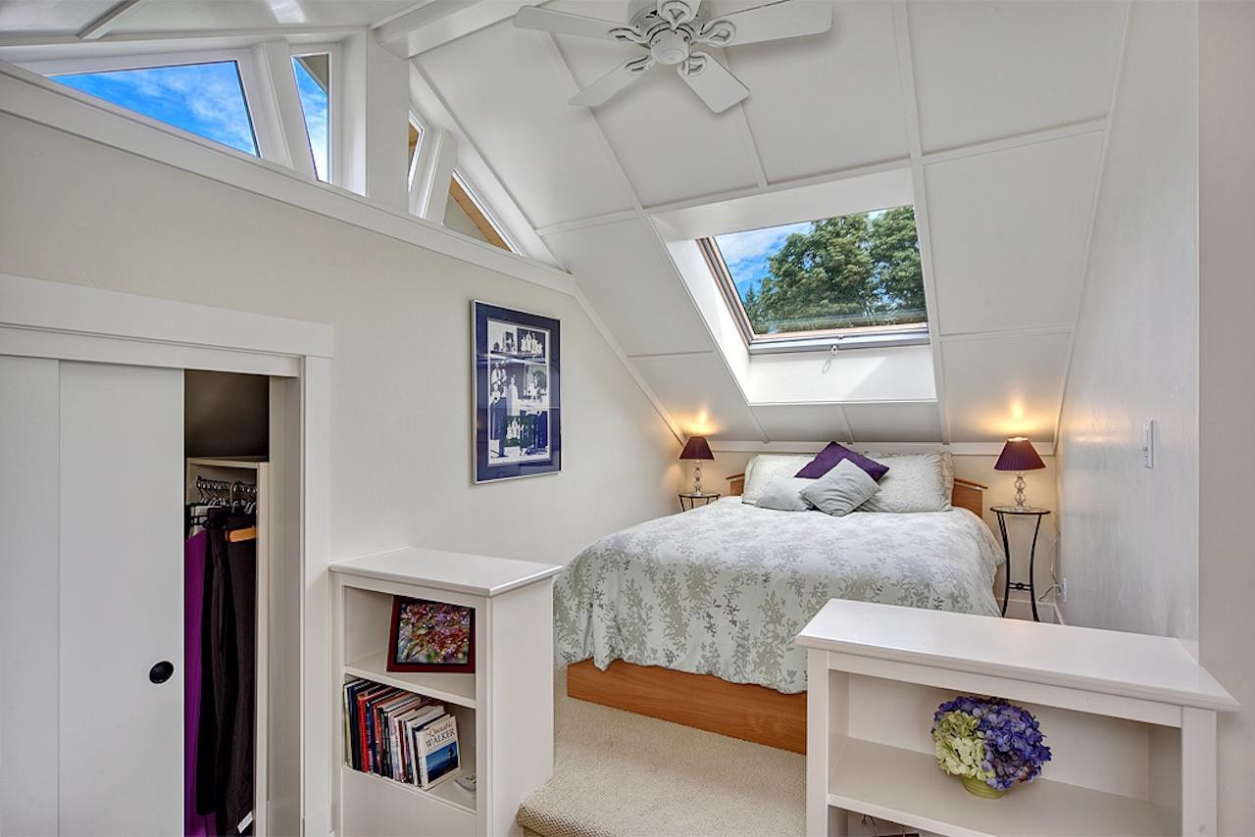

Slide 11
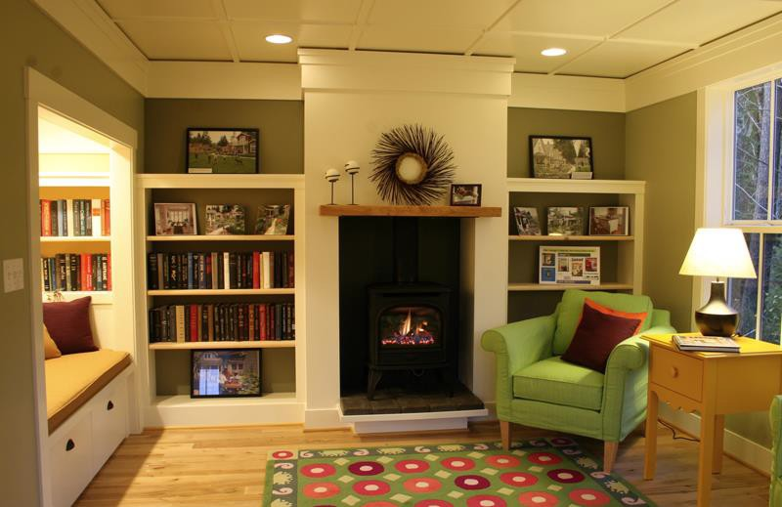

Slide 12
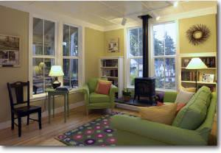

Slide 13
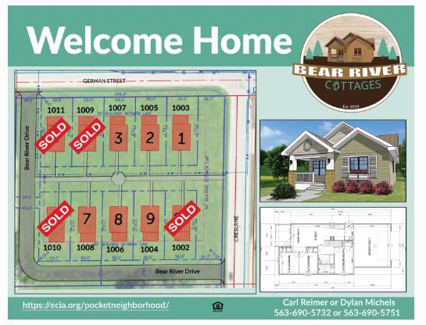

Slide 14
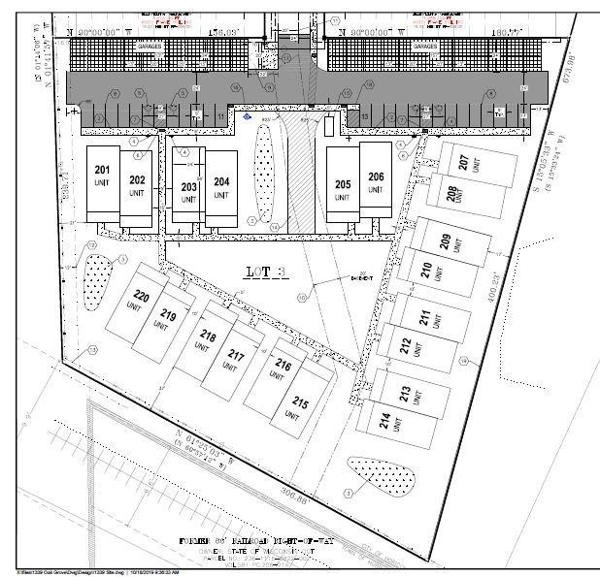
Oak Grove Phase 2 Dodge County Housing Authority Horicon, WI

Slide 15
Dwelling Details
Roughly 1,150 square feet with full high - ceiling basement
Basement ready for fourth bedroom / expansion space
Detached garage
100% ADA and / or Visitable
Renewable Energy – solar PV on roof
Low - No maintenance exterior
Cost – roughly $275,000 (panelized offsite)

Slide 16
Communities find land, purchase it, and get it properly zoned
Land would continue to owned by the
community but would be leased to the LLC
Through this lease, the long-term affordability of the site would be maintained
The Investor Member would own 99.9% of the LLC
SWCAP would own .01% of the LLC
At the end of 15 years the Investor Member
sells their interest to SWCAP for $1
The entire property is then owned by the LLC
How would a scattered site development
work

Slide 17
Land under control of the LLC, but land would not be conveyed to the LLC unless the tax credit application was successful
The land would have proper zoning
There would need to be a Market Study showing need
A Development Budget and an Operating Budget, along with Sources and Uses of Funds that where in balance
A boatload of other material and documents required by WHEDA
A Letter of Interest from a tax credit investor
Contingent financing letters from construction
and permanent lenders
Soft Funds commitments from communities, the County, not for profits, etc.
What would be needed to submit an application

Slide 18
The WHEDA application must be ready for
submittal December 1, 2020
All financing sources would need to be in place by November 1, 2020
The Construction Manager would need to be on
board with numbers that worked by October 1
The scattered sites would need to be identified by August 1. Zoning would need to be in place by December 1, 2020
What is the ideal
schedule

Slide 19
Target cost of delivered homes would be in the
$275,000 - $288,000 range, excluding land cost
Rental income gap would be filled by obtaining Project Based Section 8 vouchers for some or all units.
USDA Rural Development could provide Section 515
debt and “RA”
If no RD funding, ideally “hard debt” would come from local lenders. For 50 homes this could be in the range of $4.0 million
Tax credit equity would be in the range of $9.8 million
Total development cost would be in the range of
$14.4 million
Gap or soft financing could be in the range of
$600,000
Department of Administration HOME Funds
Federal Home Loan Bank of Chicago AHP
What is the budget / how are
gaps filled

Slide 20
Communities agree to participate and assume
the land assemblage responsibility
Dimension Development would begin the background application preparation and working with the construction manager on preliminary construction budgets
A Project Architect would need to be identified
A Market Study provider would need to be selected and engaged
SWCAP would need to work on the Childcare aspect to determine feasibility
Regular status conferences would need to be set up to keep everyone in the loop
Next Steps

