Slide 1
Cuba City Multi-Use Trail
By: Connor Girten, Duane Leis, Austen Frederickson, Dustin Moles

Slide 2
Outline
Senior Design Overview
Project Objectives
Cross Sections
Route Alternatives
Sidewalk Condition
Signage
Project Phasing
Final Cost Estimate
Grant Funding
Conclusion
Questions

Slide 3
Senior design overview
Students are assigned to a real-world project to learn and develop professional skills
Students must complete project objectives set by the client
A final recommendation must be provided at the end of the semester

Slide 4
Project Objectives
Connect popular destinations determined by community surveys
Assess condition of Cuba City’s sidewalk
Devise a plan to replace/build new sidewalk where needed
Provide a cost estimate for project
Identify potential funding sources

Slide 5
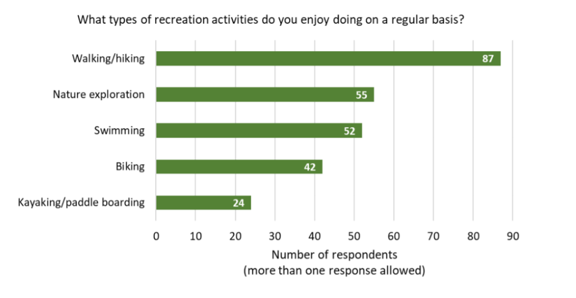
Community Input
Comprehensive Plan
Community surveys
Student surveys
Figure 1: Survey question results from comprehensive plan.

Slide 6
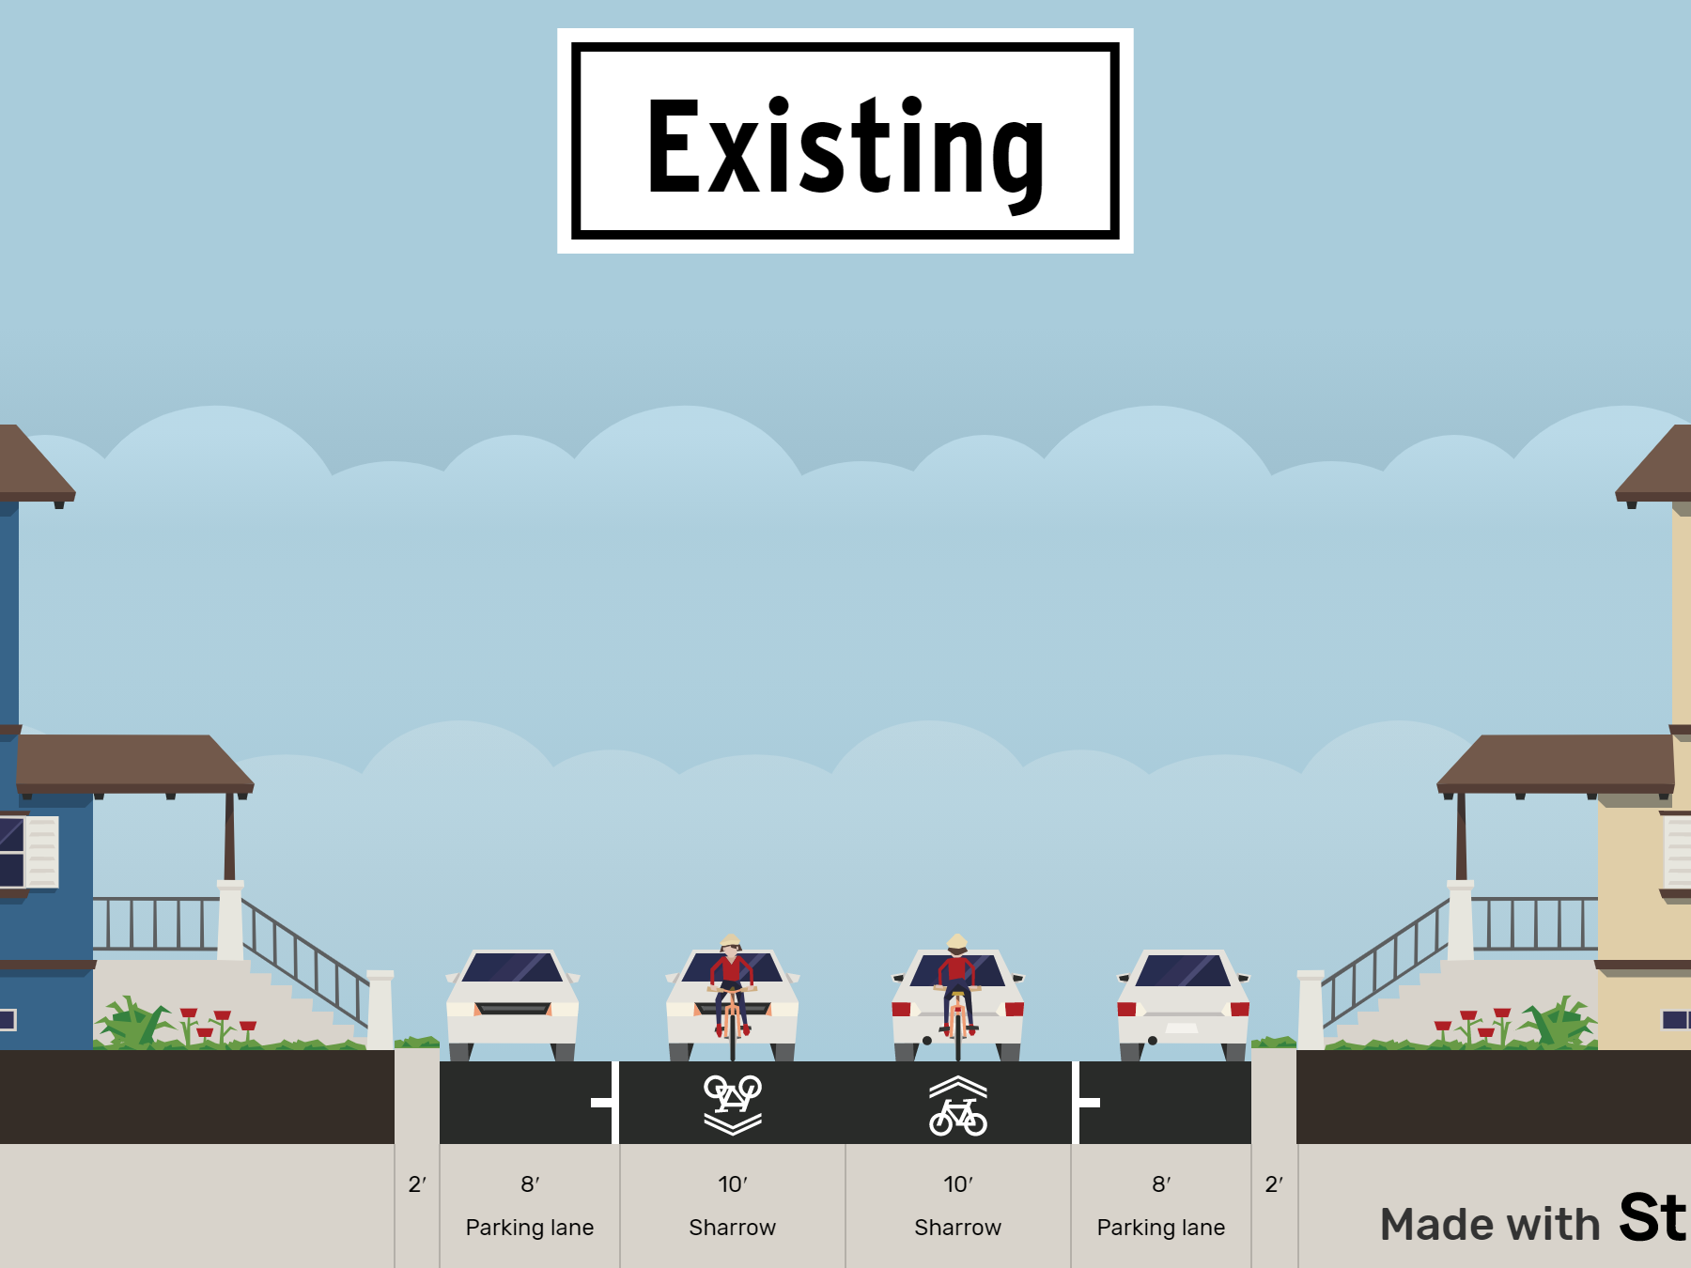
Without Sidewalk
With Sidewalk
Shared Lane
Shared Lane

Slide 7
Shared Lane
Shared Lane

Slide 9
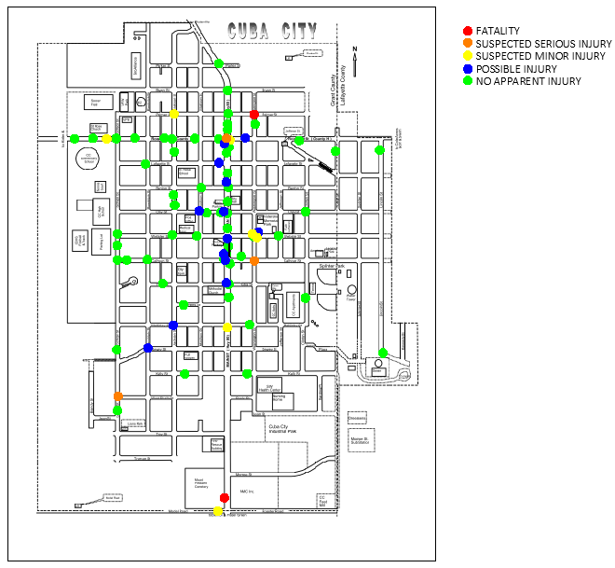
Crash Data
Reported as ped/bike involved (2 total)
Figure 2: Crash locations since 2001 reported to WisDOT

Slide 10
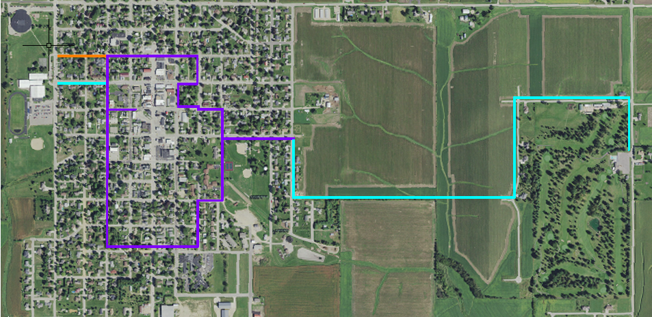
Selected Route
Legend
School
Presidential Plaza
Park
Downtown
Cole Acres
Figure 3: Combination route chosen.
Notes:
Loop = 1.9 miles

Slide 11
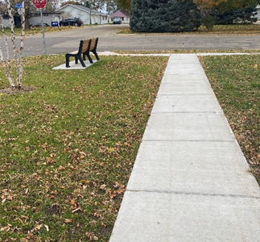
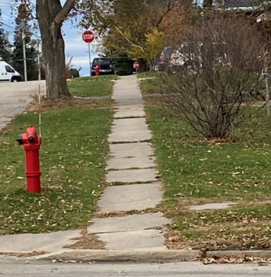
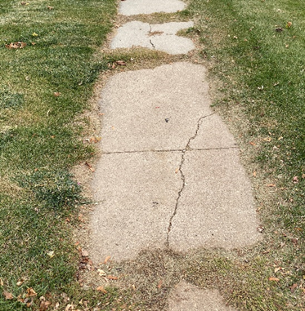
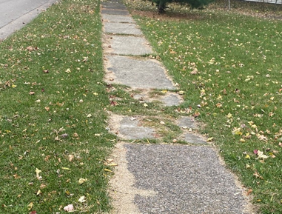
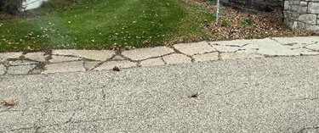
Sidewalk Condition Examples
Rating 5 on Kelly Street
Rating 4 on Benton Street
Rating 3 on Webster Street
Rating 1 on Clinton Street
Rating 2 on Washington Street

Slide 12
Sidewalk condition map
Figure 4: Map of sidewalk conditions.

Slide 13
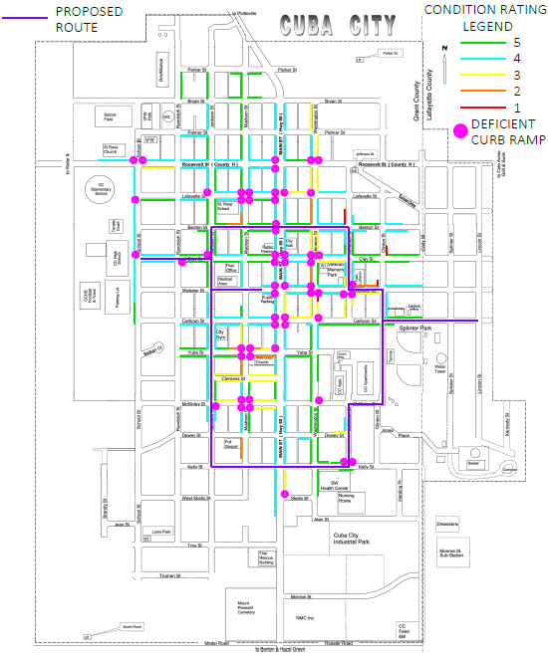
Sidewalk addition Map
Figure 5: Map of priority locations of sidewalk addition and replacement.
Replace Existing Sidewalk
New Sidewalk

Slide 14
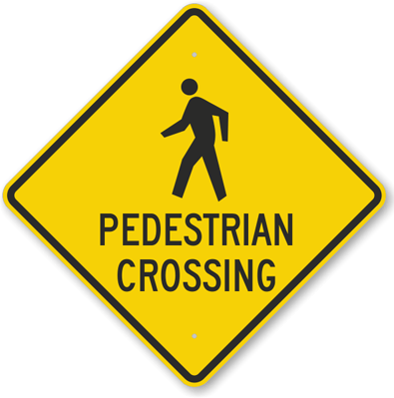
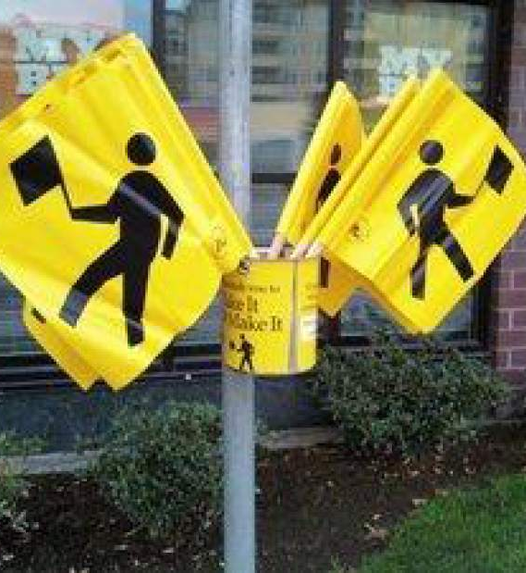
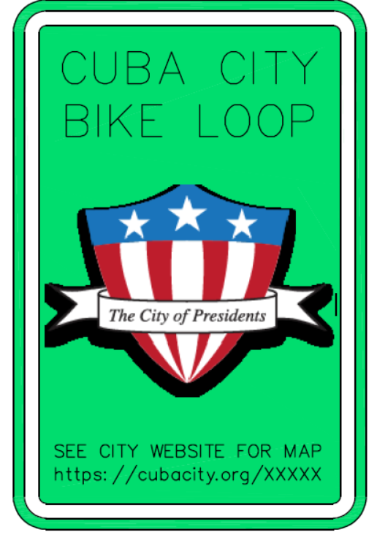
Route signage
Figure 6: Signage renderings for bicycle route.

Slide 15
Phase I (TAP)
Destinations
Phase II (WDNR/RTP)
Cole Acres connectivity
Phase III (TAP)
Expanded connectivity
Figure 7: Phasing map.
Notes:
54 houses added on phase 3

Slide 16
Grant funding
WisDot
WDNR
Transportation Alternatives Program
Promotes bicycle and pedestrian facilities to reduce vehicles on the roadway
Up to an 80% reimbursement of project costs
Phase I and Phase III qualify
Recreational Trails Program
Stewardship Local Assistance
Federal Land & Water Conservation Fund
Up to 50% cost share
Phase II qualifies

Slide 17
Cost Estimate
Table 1: Final cost estimate.
Project | Sidewalk | Curb Ramp | Asphalt Paving | Signage | Total Cost | Grant Funding | City Cost
Phase 1 | $59,000 | $4,000 | - | $900 | $63,900 | $51,120 | $12,780
Phase 2 | $60,000 | - | $80,000 | - | $140,000 | $80,000 | $60,000
Phase 3 | $126,000 | $2,000 | - | $600 | $128, 600 | $102,880 | $25,720
Total | $245,000 | $6,000 | $80,000 | $1,500 | $332,500 | $234,000 | $98,500
*sidewalk on one side of the road

Slide 18
Conclusion
Top priority is completing Phase I
Lowest cost
Connects all desired locations (excluding Cole Acres)
$63,900 before grants
$12,780 after grants
Phase II and Phase III to be determined

Slide 19
Questions?

